Slide 1
Introduction to Computing
for the Social Sciences
Session 6 - Recursion
David Garcia
Winter Semester 2024-25
27.11.2024

Slide 2
Course Outline
Session 1: Introduction
Session 2: Information Coding
Session 3: Data Structures
Session 4: Programming
Session 5: Algorithms
Session 6: Recursion
Session 7: Sorting Algorithms
Session 8: Time Complexity
Session 9: Formal Languages and Automata
Session 10: Turing Machines and Complexity Classes
Session 11: Databases
Session 12: Parallel Programming
Session 13: Social Science Applications
Session 14: Exam Review

Slide 3

Recursion example
Simpleland

Slide 4
Recursion example
A person (P) is a citizen of Simpleland if it satisfies any of these conditions:
P was born in Simpleland
either of P’s parents are citizens of Simpleland
Simpleland

Slide 5

Recursion example
A person (P) is a citizen of Simpleland if it satisfies any of these conditions:
P was born in Simpleland
either of P’s parents are citizens of Simpleland
Simpleland
Is P a citizen of Simpleland?

Slide 6
Recursion example
A person (P) is a citizen of Simpleland if it satisfies any of these conditions:
P was born in Simpleland
either of P’s parents are citizens of Simpleland
Simpleland
Is P a citizen of Simpleland?

Slide 7


Recursion example
A person (P) is a citizen of Simpleland if it satisfies any of these conditions:
P was born in Simpleland
either of P’s parents are citizens of Simpleland
Is P a citizen of Simpleland?
Simpleland

Slide 8
Recursion example
A person (P) is a citizen of Simpleland if it satisfies any of these conditions:
P was born in Simpleland
either of P’s parents are citizens of Simpleland
Is P a citizen of Simpleland?
Simpleland

Slide 9




Recursion example
A person (P) is a citizen of Simpleland if it satisfies any of these conditions:
P was born in Simpleland
either of P’s parents are citizens of Simpleland
Is P a citizen of Simpleland?
Simpleland

Slide 10
Components of Recursion
A person (P) is a citizen of Simpleland if it satisfies any of these conditions:
P was born in Simpleland
either of P’s parents are citizens of Simpleland
Base case
Simpleland

Slide 11
Components of Recursion
A person (P) is a citizen of Simpleland if it satisfies any of these conditions:
P was born in Simpleland
either of P’s parents are citizens of Simpleland
Is P a citizen of Simpleland?
Recursion case
Simpleland

Slide 12
Recursion
Definition of recursion
Recursion is a technique in mathematics, logic and computer science to specify a function through itself (a recursive definition). The fundamental principle of recursion is to define the value of a function f through previously calculated values of the same function f(n), f(n-1), ...
as long as the start value of the function f is known for sufficiently many arguments (base cases), any value of f can be calculated
a recursive call of the function f, keeps calling itself until
the function converges to a specific target value
or a pre-defined abort condition has been met

Slide 13
Issues with Recursion
A person (P) is a citizen of Simpleland if it satisfies any of these conditions:
P was born in Simpleland
either of P’s parents are citizens of Simpleland
What if we don’t know all ancestors of P?
Simpleland

Slide 14
Issues with Recursion
A person (P) is a citizen of Simpleland if it satisfies any of these conditions:
P was born in Simpleland
either of P’s parents are citizens of Simpleland
if we don’t know P’s parents, P is not a citizen of Simpleland
Abort case
Simpleland

Slide 15
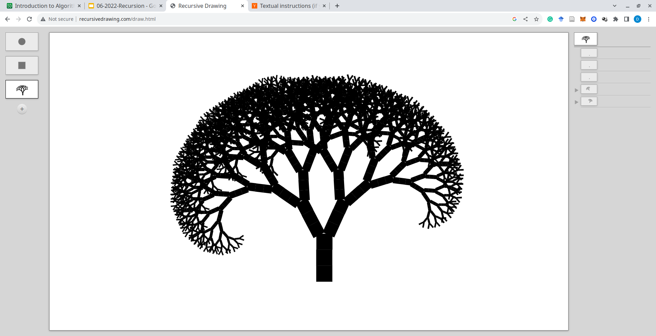
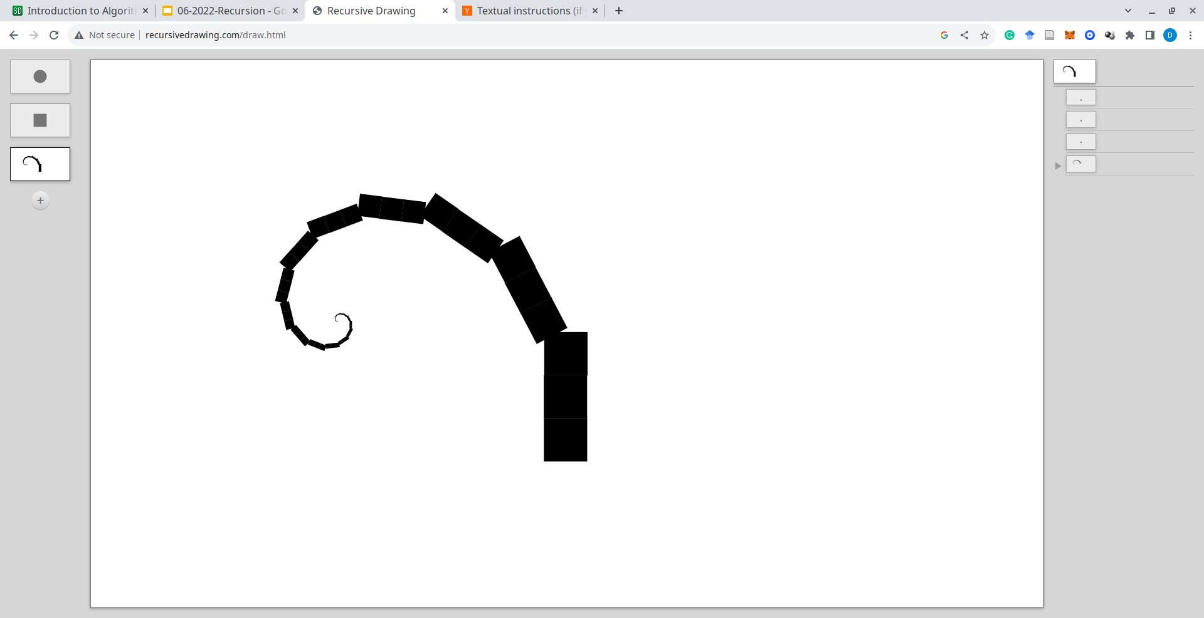

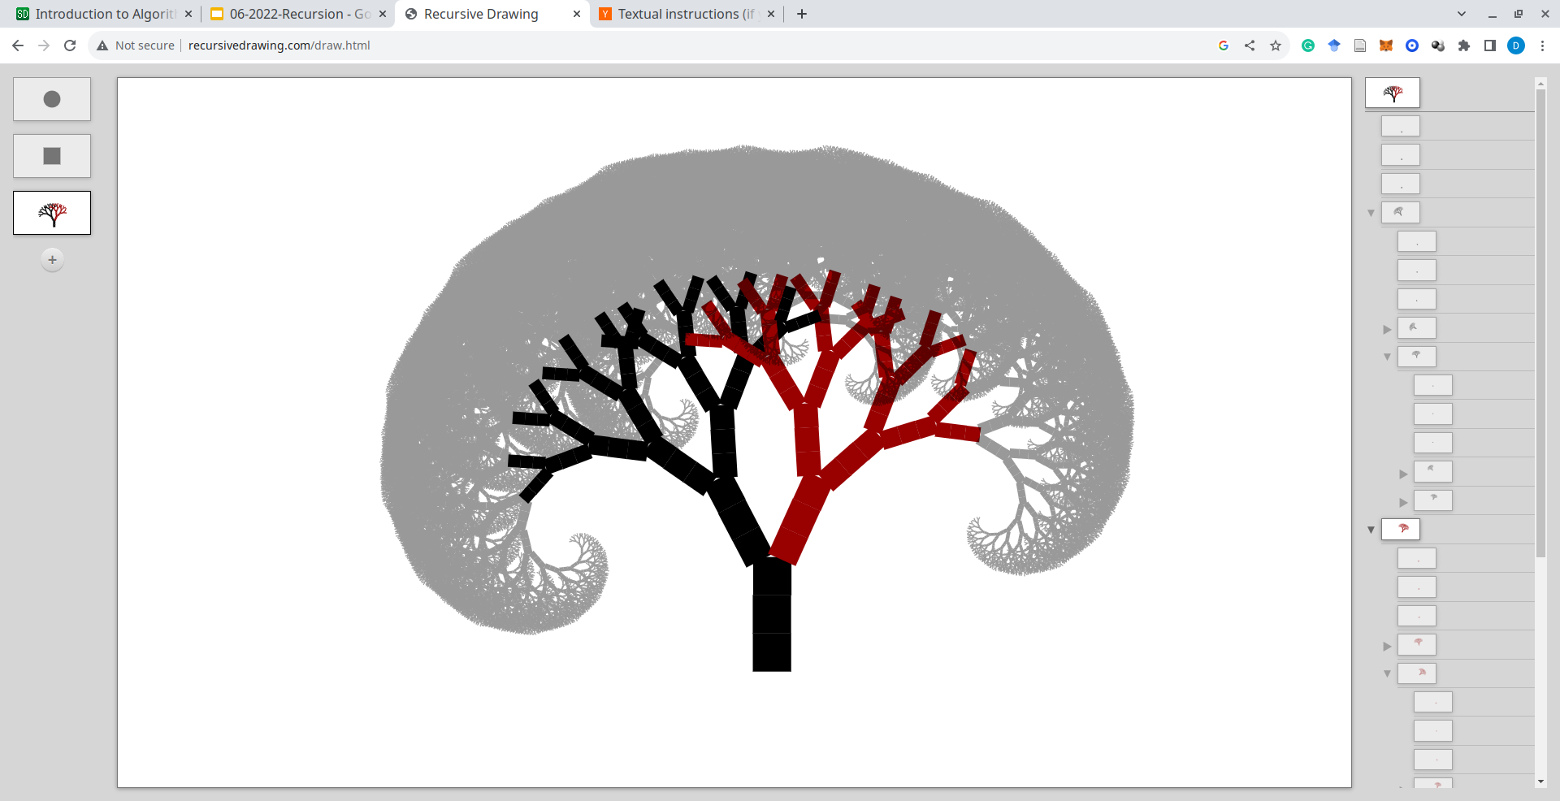
Recursion and Fractals
http://recursivedrawing.com/

Slide 16
Factorial: An Example
How many different ways exist for arranging the four diners?
1
2
3
4
Slots
Choices
4! = 4 * 3 * 2 * 1 = 24 arrangements

Slide 17
Factorial: An Example
How many different ways exist for arranging the four diners?
1
2
3
4
Slots
1
2
1
2
2
*
4
*
4
4
*
*
*
3
3
3
*
*
Choices
*
4! = 4 * 3 * 2 * 1 = 24 arrangements

Slide 18
Factorial: An Example
How many different ways exist for arranging the four diners?
1
2
3
4
Slots
1
2
1
2
2
*
4
*
4
4
*
*
*
3
3
3
*
*
Choices
*
4! = 4 * 3 * 2 * 1 = 24 arrangements
4! = 4 * 3 * 2 * 1 = 24 arrangements

Slide 19
Factorial: A Recursive Definition
Iterative definition: n! = n (n-1) (n-2) … (1)
Recursive definition: n! = n (n-1)!

Slide 20
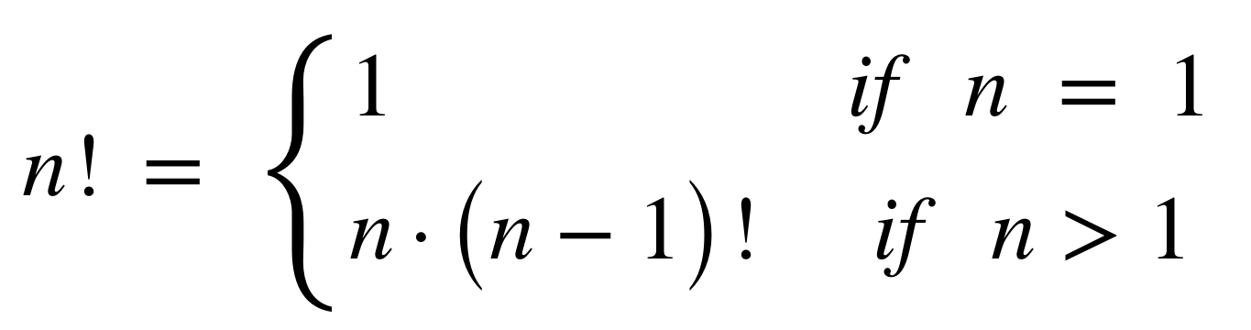
Factorial: A Recursive Definition
Iterative definition: n! = n (n-1) (n-2) … (1)
Recursive definition: n! = n (n-1)!
Base case
Recursion case

Slide 21
Factorial: Iterative Implementation
Procedure IterativeFactorial(n)
Inputs:
n: positive integer
Result: factorial of the number n
result ←1
While n > 1:
result ← result * n
n ← n - 1
return result
n! = n (n-1) (n-2) … (1)

Slide 22
Factorial: Recursive Implementation
Procedure RecursiveFactorial(n)
Inputs:
n: positive integer
Result: factorial of the number n
If n = 1
then return 1
Else
return n * RecursiveFactorial(n - 1)
n! = n (n-1)!
1! = 1

Slide 23
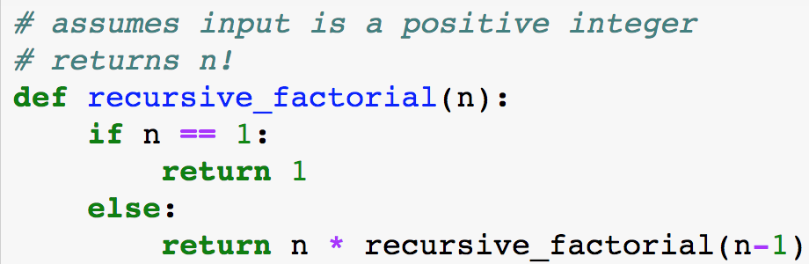
Recursive factorial in Python
n! = n (n-1)!
1! = 1

Slide 24
Factorial: Recursive Execution
Calculation can be represented as a tree
example: fac(4)
*
*
*
*
*
*
4
*
4
fac(3)
4
4
*
*
3
3
fac(2)
3
*
2
fac(1)
2
*
*
1
1
*
4
*
*
4
*
3
6
4
2
3
1
2

Slide 25
Factorial: Recursive Execution
Calculation can be represented as a tree
example: fac(4)
*
fac(3)
4

Slide 26
Factorial: Recursive Execution
Calculation can be represented as a tree
example: fac(4)
*
*
4
fac(2)
3

Slide 27
Factorial: Recursive Execution
Calculation can be represented as a tree
example: fac(4)
*
*
4
*
3
fac(1)
2

Slide 28
Factorial: Recursive Execution
Calculation can be represented as a tree
example: fac(4)
*
*
4
*
3
*
2
1
1
1

Slide 29
Factorial: Recursive Execution
Calculation can be represented as a tree
example: fac(4)
*
*
4
*
3
1
2
2

Slide 30
Factorial: Recursive Execution
Calculation can be represented as a tree
example: fac(4)
*
*
4
2
3
6

Slide 31
6
Factorial: Recursive Execution
Calculation can be represented as a tree
example: fac(4)
*
6
4
24
⇒ fac(4) = 24

Slide 32
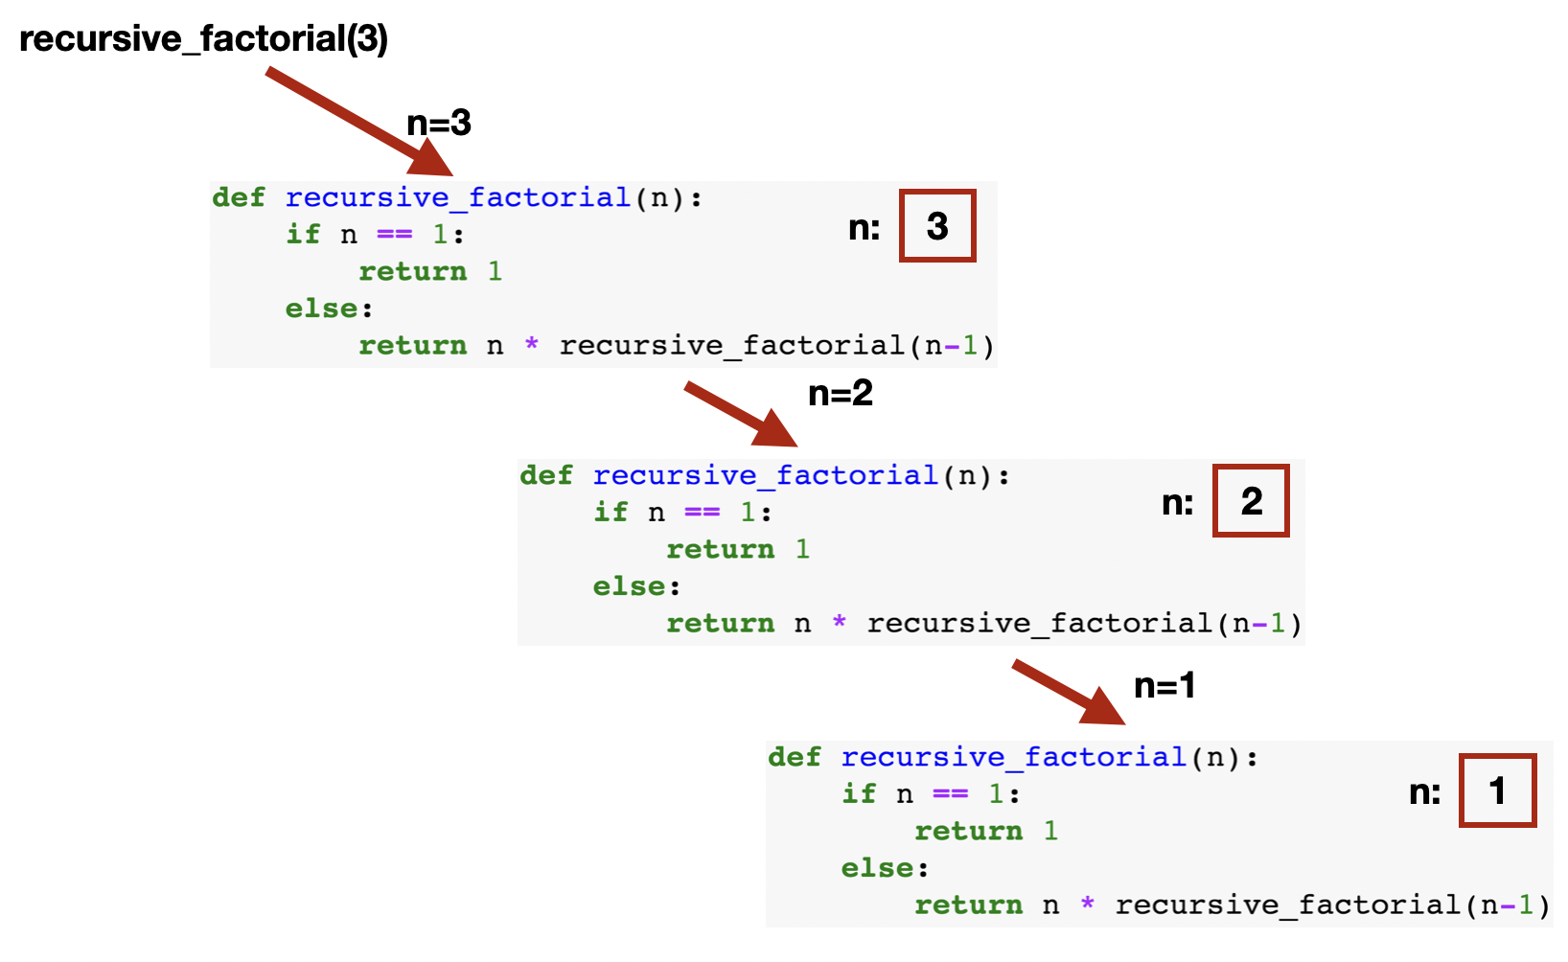
Factorial: Recursive Execution

Slide 33
Factorial: Recursive Execution

Slide 34
Factorial: Recursive Execution

Slide 35
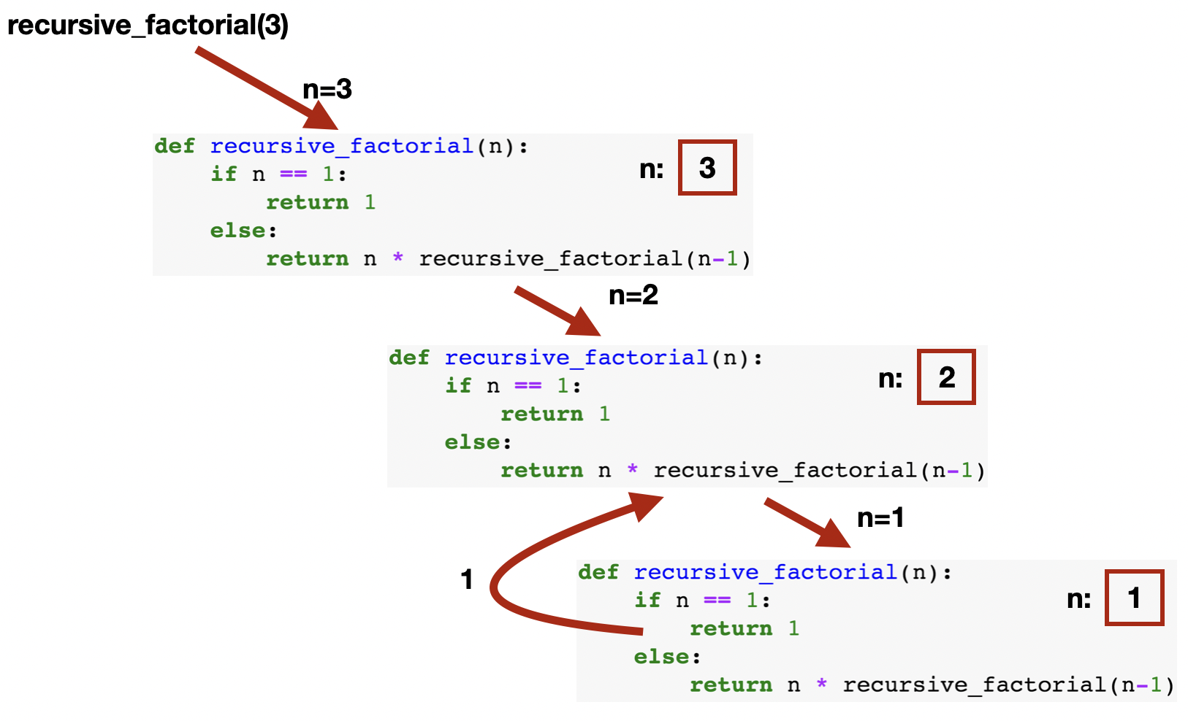
Factorial: Recursive Execution

Slide 36
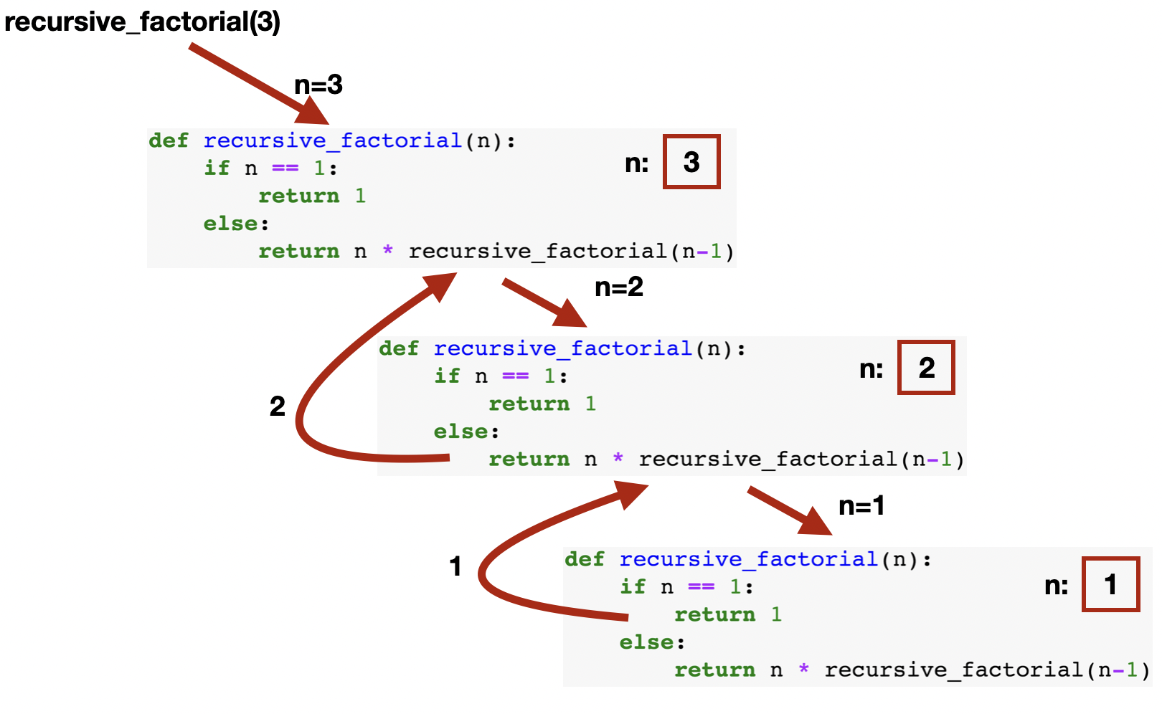
Factorial: Recursive Execution

Slide 37
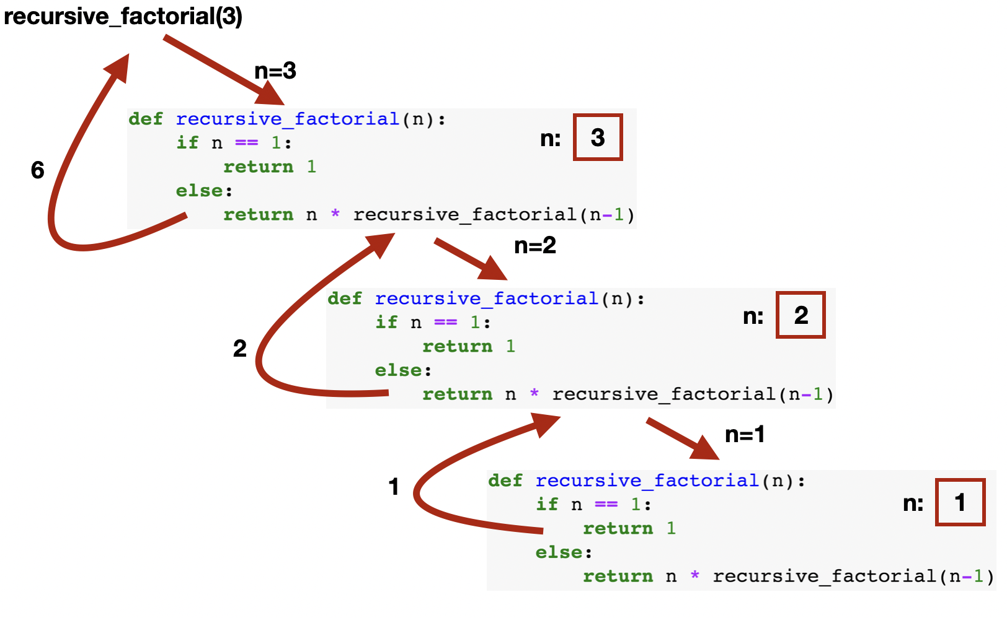
Factorial: Recursive Execution

Slide 38
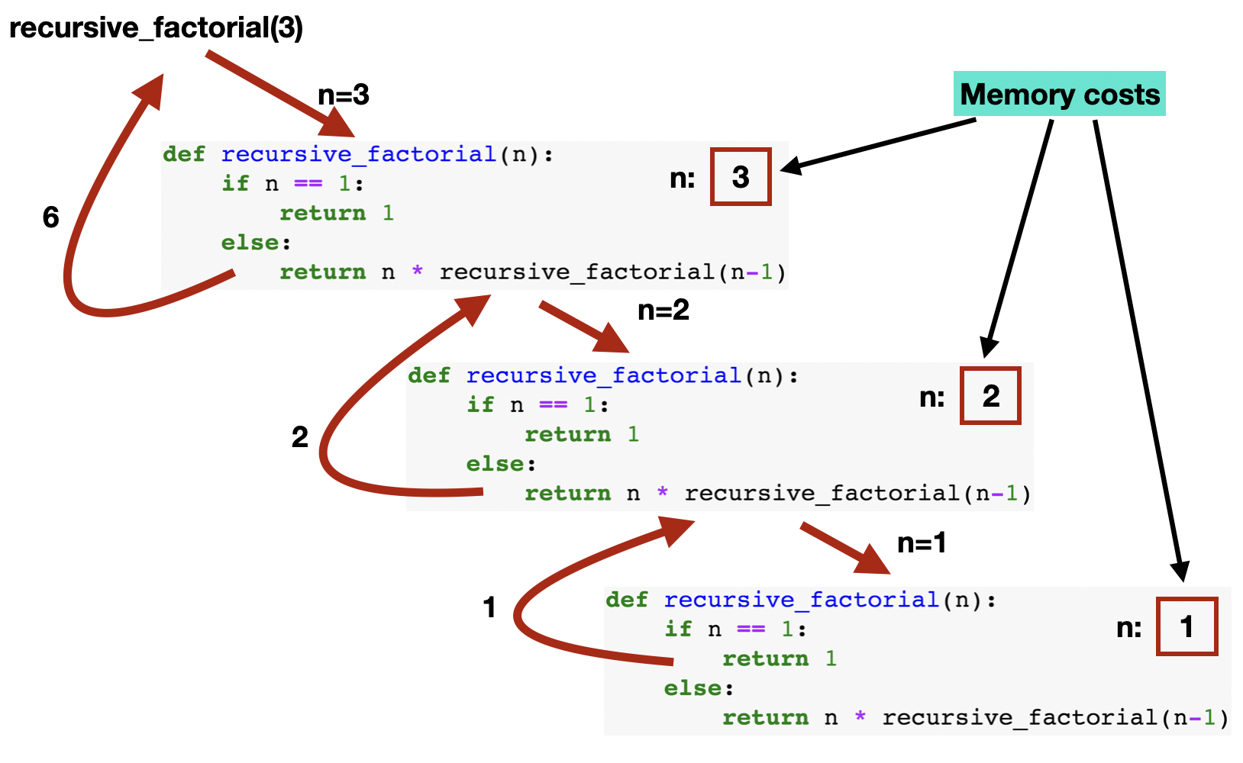
Factorial: Recursive Execution

Slide 39
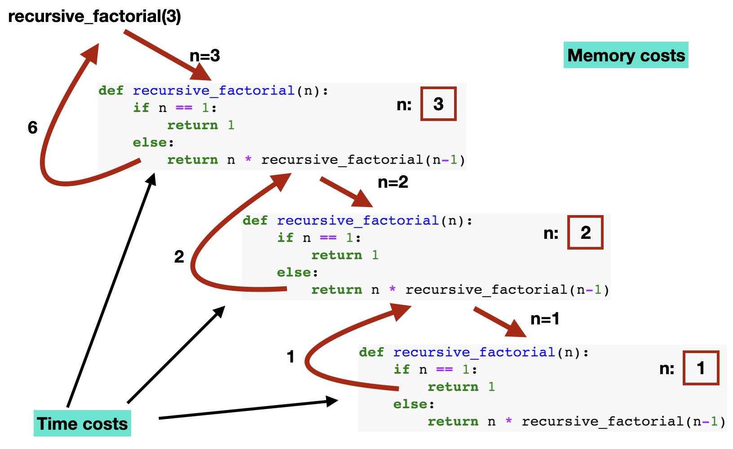
Factorial: Recursive Execution

Slide 40
Intermission: Memory of a running program
Program code (CS)
A program being run in a machine is called a process. Processes require memory to run, which is organized as follows:
Code Segment (CS)
Stack Segment (SS)
Data Segment or Heap (DS)
System
memory
Heap
Python
Memory
manager
Stack (SP) +
Variables
Memory of process
Memory of system

Slide 41
Memory of a running program
Program code (CS)
A program being run in a machine is called a process. Processes require memory to run, which is organized as follows:
Code Segment (CS)
contains executable instructions, i.e., a program loaded from hard disc
typically read-only and of fixed size
Stack Segment (SS)
Data Segment or Heap (DS)
System
memory
Heap
Python
Memory
manager
Stack (SP) +
Variables
Memory of process
Memory of system

Slide 42
Memory of a running program
Program code (CS)
A program being run in a machine is called a process. Processes require memory to run, which is organized as follows:
Code Segment (CS)
Stack Segment (SS)
contains local variables, parameters, return address
typically no execute (NX)
limited in size, e.g. 8 MB for Linux, 1 MB for Windows and Java
Data Segment or Heap (DS)
System
memory
Heap
Python
Memory
manager
Stack (SP) +
Variables
Memory of process
Memory of system

Slide 43
Memory of a running program
Program code (CS)
A program being run in a machine is called a process. Processes require memory to run, which is organized as follows:
Code Segment (CS)
Stack Segment (SS)
Data Segment or Heap (DS)
contains global data; Python manages all objects in a (private) heap
typically no execute (NX)
size is limited by main memory (RAM) or by explicit parameter when run
System
memory
Heap
Python
Memory
manager
Stack (SP) +
Variables
Memory of process
Memory of system

Slide 44

Recursion: Implementation in memory
Recursion uses the program stack:
parameters
return address
local variables
return values
stack grows and shrinks automatically with every method call
BUT has a maximum size: stack overflows are possible!
Warning: Recursion in functions easily lead to stack overflow

Slide 45


Memes warned you about recursion
3 Steps to being a good Programmer
Avoid recursion
Repeat steps 1 and 2
Always have an exit condition
Beware of being off by one

Slide 46
Outline
Recursion
Recursive Algorithms
Dynamic Programming

Slide 47
The Greatest Common Divisor
8/1=8
6/1=6
8/2=4
6/2=3
8/3=2.66…
6/3=2

Slide 48
Euclid’s algorithm
Uses the mathematical property: gcd(a,b) = gcd(b, a mod b)
Procedure GCD (a,b)
Inputs:
a,b: natural numbers (a, b ∊ ℕ); a ≥ b
Result: one value with the greatest common divisor (gcd) of a and b
If b = 0,
then t ← a
Else
t ← GCD(b, mod(a,b))
return t

Slide 49
Euclid’s algorithm
Uses the mathematical property: gcd(a,b) = gcd(b, a mod b)
gcd(270, 192)
270 mod 192 = 78
gcd(192, 78)
192 mod 78 = 36
gcd(78, 36)
78 mod 36 = 6
gcd(36, 6)
36 mod 6 = 0
gcd(6, 0)
return 6
Procedure GCD (a,b)
Inputs:
a,b: natural numbers (a, b ∊ ℕ); a ≥ b
Result: one value with the greatest common divisor (gcd) of a and b
If b = 0,
then t ← a
Else
t ← GCD(b, mod(a,b))
return t

Slide 50
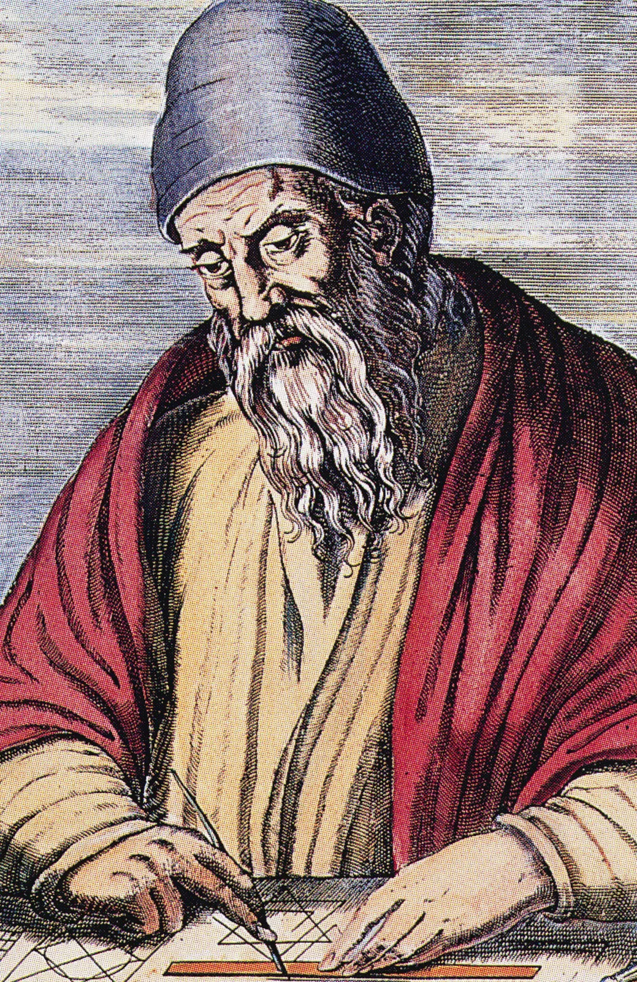
Euclid and the GCD
Euclid (~300 BC) Greek mathematician
“Euclid of Alexandria” but little is actually known about his life, neither birth year nor place
Commonly known as the father of geometry
Euclid’s most influential book is Elements, which includes the algorithm to calculate the gcd
The original version of the algorithm did subtractions on the terms instead of modulo operations but it was recursive. However, it required more steps
One of his lesser known books is titled Data (Δεδομένα), on how to study given information geometrically
Imagination of how Euclid could have looked like

Slide 51
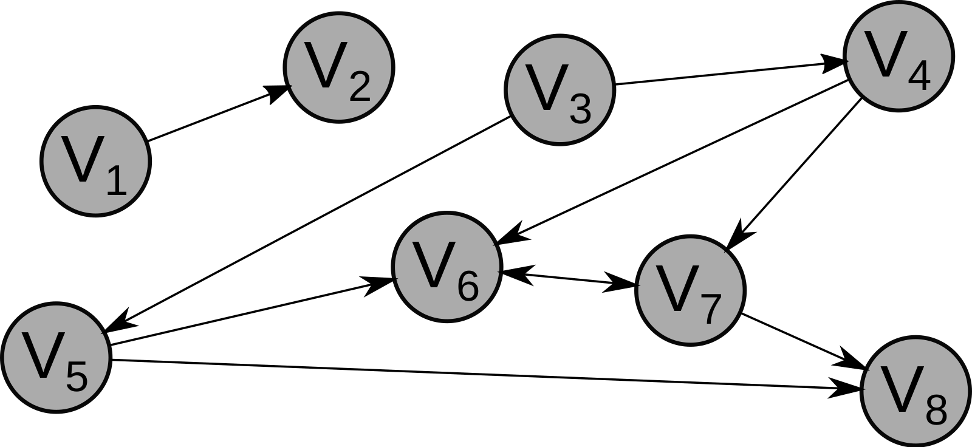
Depth-First Search in Directed Graphs
Several problems can be solved with depth-first search, such as:
Is node x included in the graph?
Does a graph have a cycle?
Helps in other problems: e.g. finding strongly connected components

Slide 52
Depth-First Search
Procedure DFS(G)
Inputs:
G: a graph
Result: A graph with information
For each vertex u in G.V
color [u] ← WHITE
π [u] ←NIL # parent
time = 0 # global count
For each vertex u in G.V
if color [u] = WHITE
then DFSVisit(G, u)
Example: Starting vertex u = c
if next node is unclear go alphabetically
NIL
NIL
NIL
NIL
b
c
d
a
/
/
/
/
/
/
/
e
f
g
NIL
NIL
NIL
time = 0
Enter For-Loop:
call DFSVisit(G, c)

Slide 53
Depth-First Search
Procedure DFSVisit(G, u)
Inputs:
G: a graph u: the node to be processed
Result: A graph with information
time = time + 1
d [u] = time # discovered
color [u] = GRAY
For each vertex v in neighbors(u):
if color [v] = WHITE
then π [v] ← u
DFSVisit(G, u)
color [u] ← BLACK
time = time + 1
f [u] = time # finished
call DFSVisit(G, c)
time = 1
C
NIL
NIL
NIL
b
c
d
a
/
1/
/
/
/
/
/
e
f
g
NIL
NIL
NIL
Enter For-Loop:
next adjacent white node: b
add parent of b
call DFSVisit(G, b)

Slide 54
Depth-First Search
Procedure DFSVisit(G, u)
Inputs:
G: a graph u: the node to be processed
Result: A graph with information
time = time + 1
d [u] = time # discovered
color [u] = GRAY
For each vertex v in neighbors(u):
if color [v] = WHITE
then π [v] ← u
DFSVisit(G, u)
color [u] ← BLACK
time = time + 1
f [u] = time # finished
call DFSVisit(G, b)
time = 2
C
NIL
NIL
NIL
b
c
d
a
2/
1/
/
/
/
/
/
e
f
g
B
NIL
NIL
Enter For-Loop:
next adjacent white node: e
add parent of e
call DFSVisit(G, e)

Slide 55
Depth-First Search
Procedure DFSVisit(G, u)
Inputs:
G: a graph u: the node to be processed
Result: A graph with information
time = time + 1
d [u] = time # discovered
color [u] = GRAY
For each vertex v in neighbors(u):
if color [v] = WHITE
then π [v] ← u
DFSVisit(G, u)
color [u] ← BLACK
time = time + 1
f [u] = time # finished
call DFSVisit(G, e)
time = 3
C
NIL
NIL
E
b
c
d
a
2/
1/
/
/
3/
/
/
e
f
g
B
NIL
NIL
Enter For-Loop:
next adjacent white node: a
add parent of a
call DFSVisit(G, a)

Slide 56
Depth-First Search
Procedure DFSVisit(G, u)
Inputs:
G: a graph u: the node to be processed
Result: A graph with information
time = time + 1
d [u] = time # discovered
color [u] = GRAY
For each vertex v in neighbors(u):
if color [v] = WHITE
then π [v] ← u
DFSVisit(G, u)
color [u] ← BLACK
time = time + 1
f [u] = time # finished
call DFSVisit(G, a)
time = 4
C
NIL
NIL
E
b
c
d
a
2/
1/
/
4/
3/
/
/
e
f
g
B
NIL
NIL
Enter For-Loop:
no adjacent white nodes
finish DFSVisit(G, a)

Slide 57
Depth-First Search
Procedure DFSVisit(G, u)
Inputs:
G: a graph u: the node to be processed
Result: A graph with information
time = time + 1
d [u] = time # discovered
color [u] = GRAY
For each vertex v in neighbors(u):
if color [v] = WHITE
then π [v] ← u
DFSVisit(G, u)
color [u] ← BLACK
time = time + 1
f [u] = time # finished
finish DFSVisit(G, a)
time = 5
C
NIL
NIL
E
b
c
d
a
2/
1/
/
4/5
3/
/
/
e
f
g
B
NIL
NIL
return to For-Loop of DFSVisit(G, e)

Slide 58
Depth-First Search
Procedure DFSVisit(G, u)
Inputs:
G: a graph u: the node to be processed
Result: A graph with information
time = time + 1
d [u] = time # discovered
color [u] = GRAY
For each vertex v in neighbors(u):
if color [v] = WHITE
then π [v] ← u
DFSVisit(G, u)
color [u] ← BLACK
time = time + 1
f [u] = time # finished
return to For-Loop of DFSVisit(G, e)
time = 5
C
NIL
NIL
E
b
c
d
a
2/
1/
/
4/5
3/
/
/
e
f
g
B
E
NIL
Back in the For-Loop:
next adjacent white node: f
add parent of f
call DFSVisit(G, f)

Slide 59
Depth-First Search
Procedure DFSVisit(G, u)
Inputs:
G: a graph u: the node to be processed
Result: A graph with information
time = time + 1
d [u] = time # discovered
color [u] = GRAY
For each vertex v in neighbors(u):
if color [v] = WHITE
then π [v] ← u
DFSVisit(G, u)
color [u] ← BLACK
time = time + 1
f [u] = time # finished
call DFSVisit(G, f)
time = 6
C
NIL
NIL
E
b
c
d
a
2/
1/
/
4/5
3/
6/
/
e
f
g
B
E
NIL
Enter the For-Loop:
no adjacent white nodes
finish DFS(G, f)

Slide 60
Depth-First Search
Procedure DFSVisit(G, u)
Inputs:
G: a graph u: the node to be processed
Result: A graph with information
time = time + 1
d [u] = time # discovered
color [u] = GRAY
For each vertex v in neighbors(u):
if color [v] = WHITE
then π [v] ← u
DFSVisit(G, u)
color [u] ← BLACK
time = time + 1
f [u] = time # finished
finish DFSVisit(G, f)
time = 7
C
NIL
NIL
E
b
c
d
a
2/
1/
/
4/5
3/
6/7
/
e
f
g
B
E
NIL
return to For-Loop of DFSVisit(G, e)

Slide 61
Depth-First Search
Procedure DFSVisit(G, u)
Inputs:
G: a graph u: the node to be processed
Result: A graph with information
time = time + 1
d [u] = time # discovered
color [u] = GRAY
For each vertex v in neighbors(u):
if color [v] = WHITE
then π [v] ← u
DFSVisit(G, u)
color [u] ← BLACK
time = time + 1
f [u] = time # finished
return to For-Loop of DFSVisit(G, e)
time = 7
C
NIL
NIL
E
b
c
d
a
2/
1/
/
4/5
3/
6/7
/
e
f
g
B
E
NIL
Back in the For-Loop:
no adjacent white nodes
finish DFSVisit(G, e)

Slide 62
Depth-First Search
Procedure DFSVisit(G, u)
Inputs:
G: a graph u: the node to be processed
Result: A graph with information
time = time + 1
d [u] = time # discovered
color [u] = GRAY
For each vertex v in neighbors(u):
if color [v] = WHITE
then π [v] ← u
DFSVisit(G, u)
color [u] ← BLACK
time = time + 1
f [u] = time # finished
finish DFSVisit(G, e)
time = 8
C
NIL
NIL
E
b
c
d
a
2/
1/
/
4/5
3/8
6/7
/
e
f
g
B
E
NIL
return to For-Loop of DFSVisit(G, b)

Slide 63
Depth-First Search
Procedure DFSVisit(G, u)
Inputs:
G: a graph u: the node to be processed
Result: A graph with information
time = time + 1
d [u] = time # discovered
color [u] = GRAY
For each vertex v in neighbors(u):
if color [v] = WHITE
then π [v] ← u
DFSVisit(G, u)
color [u] ← BLACK
time = time + 1
f [u] = time # finished
return to For-Loop of DFSVisit(G, b)
time = 8
C
NIL
NIL
E
b
c
d
a
2/
1/
/
4/5
3/8
6/7
/
e
f
g
B
E
NIL
Back in the For-Loop:
no adjacent white nodes
finish DFSVisit(G, b)

Slide 64
Depth-First Search
Procedure DFSVisit(G, u)
Inputs:
G: a graph u: the node to be processed
Result: A graph with information
time = time + 1
d [u] = time # discovered
color [u] = GRAY
For each vertex v in neighbors(u):
if color [v] = WHITE
then π [v] ← u
DFSVisit(G, u)
color [u] ← BLACK
time = time + 1
f [u] = time # finished
finish DFSVisit(G, b)
time = 9
C
NIL
NIL
E
b
c
d
a
2/9
1/
/
4/5
3/8
6/7
/
e
f
g
B
E
NIL
return to For-Loop of DFSVisit(G, c)

Slide 65
Depth-First Search
Procedure DFSVisit(G, u)
Inputs:
G: a graph u: the node to be processed
Result: A graph with information
time = time + 1
d [u] = time # discovered
color [u] = GRAY
For each vertex v in neighbors(u):
if color [v] = WHITE
then π [v] ← u
DFSVisit(G, u)
color [u] ← BLACK
time = time + 1
f [u] = time # finished
return to For-Loop of DFSVisit(G, c)
time = 9
C
NIL
NIL
E
b
c
d
a
2/9
1/
/
4/5
3/8
6/7
/
e
f
g
B
E
C
Back in the For-Loop:
next adjacent white node: g
add parent of g
call DFSVisit(G, g)

Slide 66
Depth-First Search
Procedure DFSVisit(G, u)
Inputs:
G: a graph u: the node to be processed
Result: A graph with information
time = time + 1
d [u] = time # discovered
color [u] = GRAY
For each vertex v in neighbors(u):
if color [v] = WHITE
then π [v] ← u
DFSVisit(G, u)
color [u] ← BLACK
time = time + 1
f [u] = time # finished
call DFSVisit(G, g)
time = 10
C
NIL
G
E
b
c
d
a
2/9
1/
/
4/5
3/8
6/7
10/
e
f
g
B
E
C
Enter the For-Loop:
next adjacent white node: d
add parent of d
call DFSVisit(G, d)

Slide 67
Depth-First Search
Procedure DFSVisit(G, u)
Inputs:
G: a graph u: the node to be processed
Result: A graph with information
time = time + 1
d [u] = time # discovered
color [u] = GRAY
For each vertex v in neighbors(u):
if color [v] = WHITE
then π [v] ← u
DFSVisit(G, u)
color [u] ← BLACK
time = time + 1
f [u] = time # finished
call DFSVisit(G, d)
time = 11
C
NIL
G
E
b
c
d
a
2/9
1/
11/
4/5
3/8
6/7
10/
e
f
g
B
E
C
Enter the For-Loop:
no adjacent white nodes
finish DFSVisit(G, d)

Slide 68
Depth-First Search
Procedure DFSVisit(G, u)
Inputs:
G: a graph u: the node to be processed
Result: A graph with information
time = time + 1
d [u] = time # discovered
color [u] = GRAY
For each vertex v in neighbors(u):
if color [v] = WHITE
then π [v] ← u
DFSVisit(G, u)
color [u] ← BLACK
time = time + 1
f [u] = time # finished
finish DFSVisit(G, d)
time = 12
C
NIL
G
E
b
c
d
a
2/9
1/
11/12
4/5
3/8
6/7
10/
e
f
g
B
E
C
return to For-Loop of DFSVisit(G, g)

Slide 69
Depth-First Search
Procedure DFSVisit(G, u)
Inputs:
G: a graph u: the node to be processed
Result: A graph with information
time = time + 1
d [u] = time # discovered
color [u] = GRAY
For each vertex v in neighbors(u):
if color [v] = WHITE
then π [v] ← u
DFSVisit(G, u)
color [u] ← BLACK
time = time + 1
f [u] = time # finished
return to For-Loop of DFSVisit(G, g)
time = 12
C
NIL
G
E
b
c
d
a
2/9
1/
11/12
4/5
3/8
6/7
10/
e
f
g
B
E
C
Back in the For-Loop:
no adjacent white nodes
finish DFSVisit(G, g)

Slide 70
Depth-First Search
Procedure DFSVisit(G, u)
Inputs:
G: a graph u: the node to be processed
Result: A graph with information
time = time + 1
d [u] = time # discovered
color [u] = GRAY
For each vertex v in neighbors(u):
if color [v] = WHITE
then π [v] ← u
DFSVisit(G, u)
color [u] ← BLACK
time = time + 1
f [u] = time # finished
finish DFSVisit(G, g)
time = 13
C
NIL
G
E
b
c
d
a
2/9
1/
11/12
4/5
3/8
6/7
10/13
e
f
g
B
E
C
return to For-Loop of DFSVisit(G, c)

Slide 71
Depth-First Search
Procedure DFSVisit(G, u)
Inputs:
G: a graph u: the node to be processed
Result: A graph with information
time = time + 1
d [u] = time # discovered
color [u] = GRAY
For each vertex v in neighbors(u):
if color [v] = WHITE
then π [v] ← u
DFSVisit(G, u)
color [u] ← BLACK
time = time + 1
f [u] = time # finished
return to For-Loop of DFSVisit(G, c)
time = 13
C
NIL
G
E
b
c
d
a
2/9
1/
11/12
4/5
3/8
6/7
10/13
e
f
g
B
E
C
Back in the For-Loop:
no adjacent white nodes
finish DFSVisit(G, c)

Slide 72
Depth-First Search
Procedure DFSVisit(G, u)
Inputs:
G: a graph u: the node to be processed
Result: A graph with information
time = time + 1
d [u] = time # discovered
color [u] = GRAY
For each vertex v in neighbors(u):
if color [v] = WHITE
then π [v] ← u
DFSVisit(G, u)
color [u] ← BLACK
time = time + 1
f [u] = time # finished
finish DFSVisit(G, c)
time = 14
C
NIL
G
E
b
c
d
a
2/9
1/14
11/12
4/5
3/8
6/7
10/13
e
f
g
B
E
C
All nodes finished
→ FINISHED

Slide 73
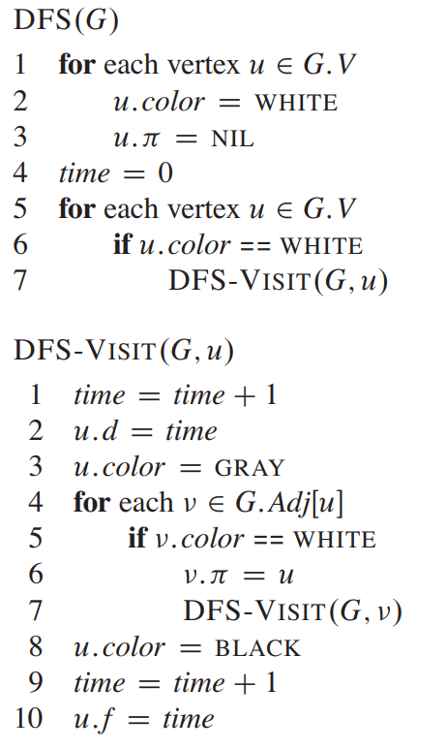
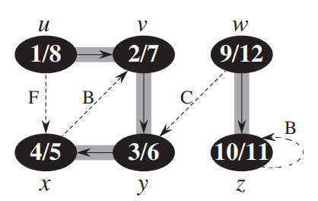
More on Depth-First Search: See Cormen (2009)
From Introduction to Algorithms by Thomas Cormen (2009)

Slide 74
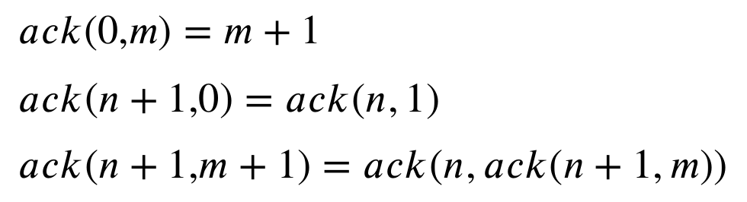
Types of recursive algorithms
linear recursion
method calls itself once recursively e.g., factorial, gcd
tree or cascade recursion
method calls itself multiple times recursively e.g., DFS, fibonacci numbers (next section)
tail-end recursion
return value of a function is calculated as a call to itself and nothing else
gcd is tail-recursive
result of the last recursive call is the final return value
other types: nested recursion
parameters of the method contain recursive calls e.g., Ackermann function:

Slide 75
Outline
Recursion
Recursive Algorithms
Dynamic Programming

Slide 76
Optimization Problems (Motivation)
An optimization problem consists of maximizing or minimizing a real function by systematically choosing input values from within an allowed set and computing the value of the function
finding “best available” values of some objective function given a defined domain or input
many problems in applied social science research actually have this structure
optimizing a statistical model
optimizing the parameters of a simulation model
calculating the shortest geographical path

Slide 77
Dynamic Programming
Definition of dynamic programming Dynamic programming refers to simplifying a complicated problem by breaking it down into simpler sub-problems and saving the result for the future so that we will not have to compute that same problem again.
While some problems cannot be taken apart this way, problems that span several points in time often do break apart recursively.
both a mathematical optimization method and an algorithm design principle
common technique used in engineering and economics; goes back to the idea of Richard Bellmann in the 1950s
optimal substructure: if a problem can be solved optimally by breaking into sub-problems and recursively finding optimal solutions to sub-problems

Slide 78
Dynamic Programming
Idea behind dynamical programming
use recursion but also save and re-use intermediate solutions:
breaking down an optimization problem into simpler sub-problems, and storing the solution to each sub-problem (called memoization) so that each sub-problem is only solved once.
step-by-step put overlapping partial solutions together to form the overall solutions
requires checking global values at intermediate steps using all partial solutions
typical implementation through iteratively “filling up” an array or a matrix
makes code faster by reducing time complexity (reduced compute cycles) by efficient use of space

Slide 79
Example: Fibonacci numbers
Algorithm for fibonacci(n) - recursive version
Input: n ∈ N;
Output: The nth entry in the Fibonacci sequence
fib(n)
if n = 0:
return 0
if n = 1:
return 1
return fib(n - 1) + fib(n - 2)
The number of calls to fib(n) grows exponentially with n

Slide 80
Example: Fibonacci numbers
Algorithm for fibonacci(n) - recursive but more efficient
Input: n ∈ N;
Output: The nth entry in the Fibonacci sequence
Data: memo array initially all set to NIL
fib(n)
if n = 0:
return 0
if n = 1:
return 1
if memo[n] != NIL:
return memo[n]
memo[n] = fib(n-1) + fib(n-2)
return memo[n]

Slide 81
Example: Fibonacci numbers
Algorithm for fibonacci(n) - recursive but more efficient
Input: n ∈ N;
Output: The nth entry in the Fibonacci sequence
Data: memo array initially all set to NIL
fib(n)
if n = 0:
return 0
if n = 1:
return 1
if memo[n] != NIL:
return memo[n]
memo[n] = fib(n-1) + fib(n-2)
return memo[n]
Previously calculated results are saved in memo

Slide 82
Example: Fibonacci numbers
Algorithm for fibonacci(n) - fully iterative
Input: n ∈ N;
Output: The nth entry in the Fibonacci sequence
Data: memo array
fib(n):
memo[0] = 0
memo[1] = 1
for i from 2 to n+1:
memo[i] = memo[i-1] + memo[i-2]
return memo[n]

Slide 83
Outtake – Social Science Applications
The most prevalent problem-solving heuristics you will encounter
Recursion
optimization through recursive function call, e.g. DFS
requires specifying sensible abort conditions
Greedy
successive extension of partial solutions, e.g. BFS
determines locally optimal choice at each step, then moves on
only correct if local optimum also leads to globally optimal solutions
Divide and Conquer
separate the problem into decoupled/non-overlapping smaller sub-problems. More next session!
solve sub-problems independently
if necessary, collapse all sub-results to global results

Slide 84
Next Session
Sorting Algorithms
Divide and Conquer Algorithms

